Slide 1

Factors Driving House Prices
MELIKE KARAMAN YILMAZ
Notes:
Hi, My name is Melike. Today, I will talk about the factors that driving house prices.

Slide 2
Introduction
Banks give long-term loans to those who want to buy a house. Although the interest on the borrowed debt sounds good, this sometimes creates a big risk. Because of this reasons, understanding how to allocate dollars for investing in mortgage-backed securities is crucial.
Today, we will analyze the factors affecting house prices with data on 1450 houses sold between 2006 and 2010 in Ames, lowa.
Resource : https://www.kaggle.com/c/house-prices-advanced-regression-techniques/data

Slide 3
Overview
Descriptive Statistic for sales prices
Mean | 180921.20
Standard Error | 2079.11
Median | 163000.00
Mode | 140000.00
Standard Deviation | 79442.50
Sample Variance | 6311111264.30
Kurtosis | 6.54
Skewness | 1.88
Range | 720100.00
Minimum | 34900.00
Maximum | 755000.00
Sum | 264144946.00
Count | 1460
Sum of Sales: $264K
Avg. of Sales: $ 181K
Max. of Sales Price: $755K
Min of Sales Price: $35K
Total Count of Sales: 1460
* Test was performed and found that with 95% confidence
Notes:
Here is the overview about our data.

Slide 4
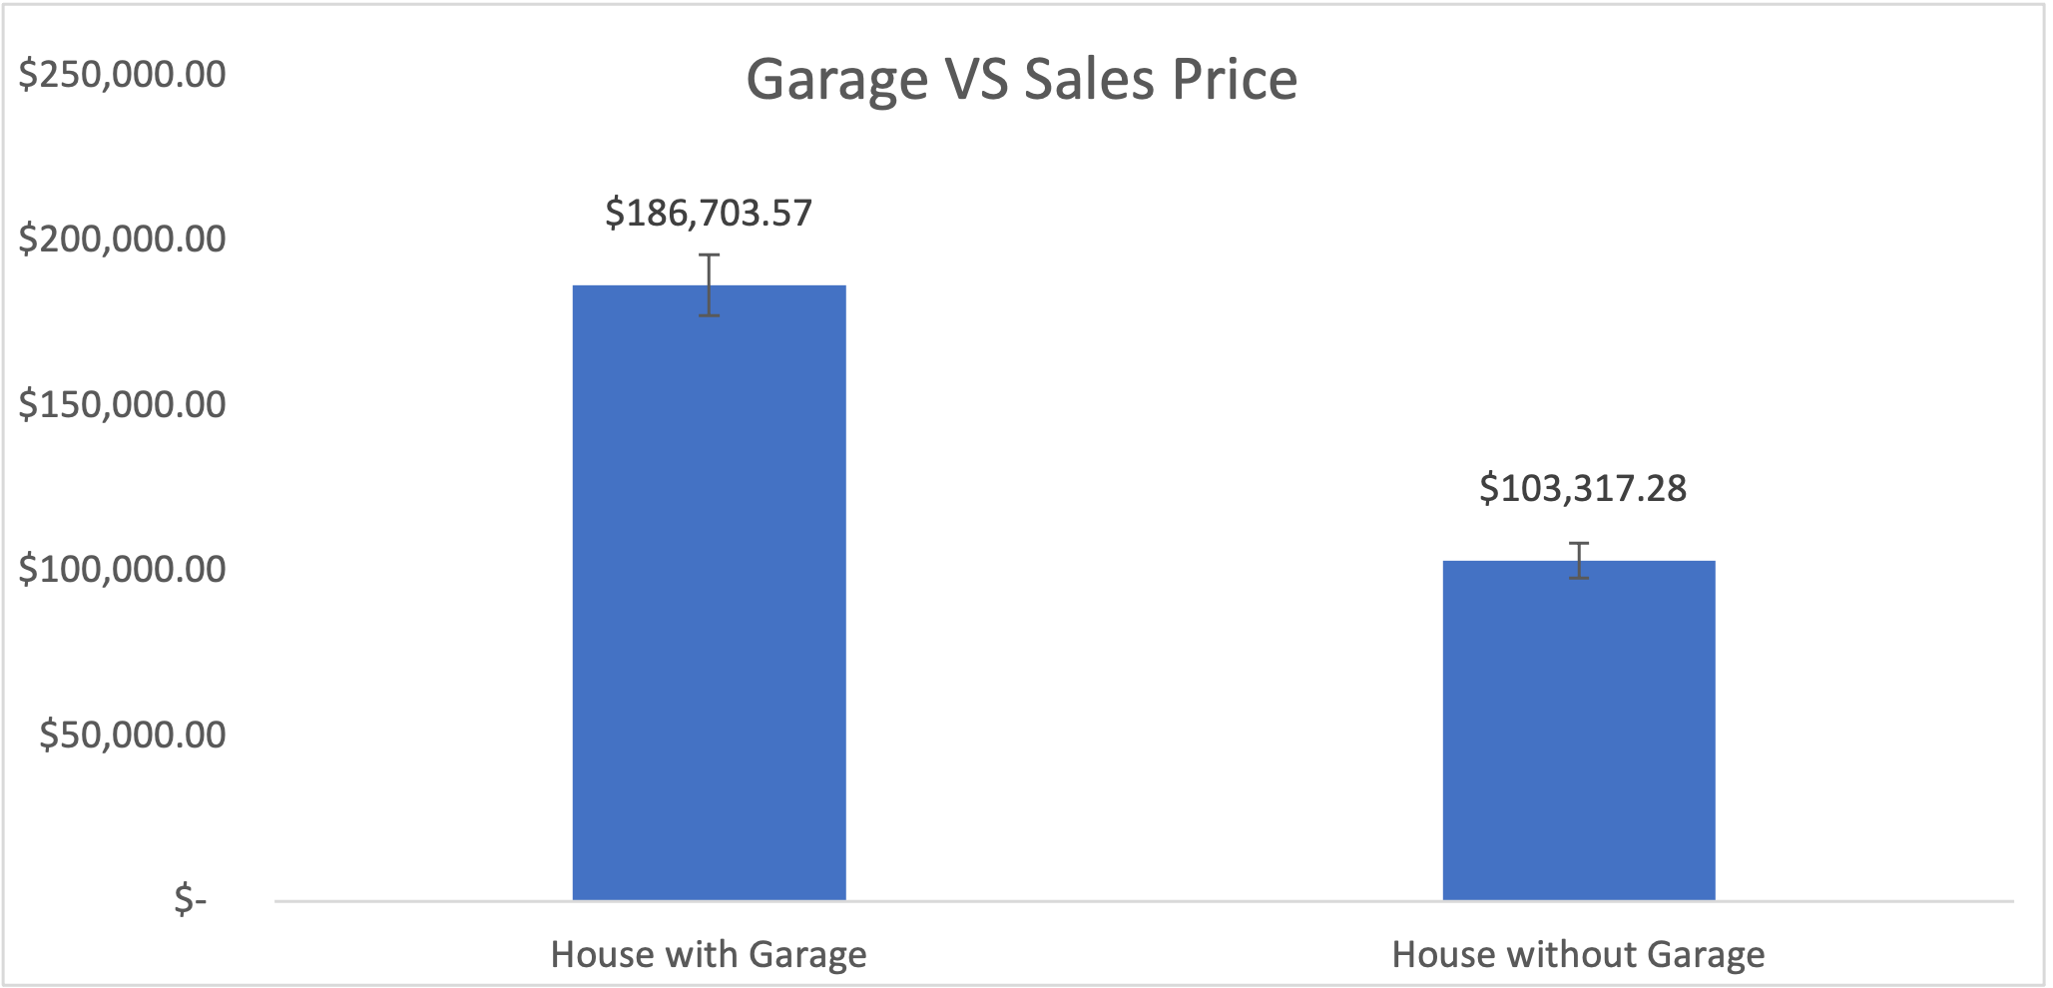
1. The effect of the garage on the selling price
T-test: Ho=no difference in mean, Ha:=difference
Garage Car>0 vs. Garage Car= 0
P<.05 at 1.52049E-43
Recommendation: Houses with garages are sold at higher prices than houses without a garage and are in greater demand.
Reject the null that there is no difference between the population means of number of Car Garages and and Sales Price.
This difference is significant at the <.05 level. With 95% confidence, the difference is between 74644 and 92129 means.
Notes:
First , I would like to start with Garage cars.I run the t-test to compare house with garage and house without garage. There is significant difference at .05level with 95 confidence. Result of the test showed us houses with garage are sold at higher prices than houses without a garage. They are also in greater demand as we see on the chart.

Slide 5
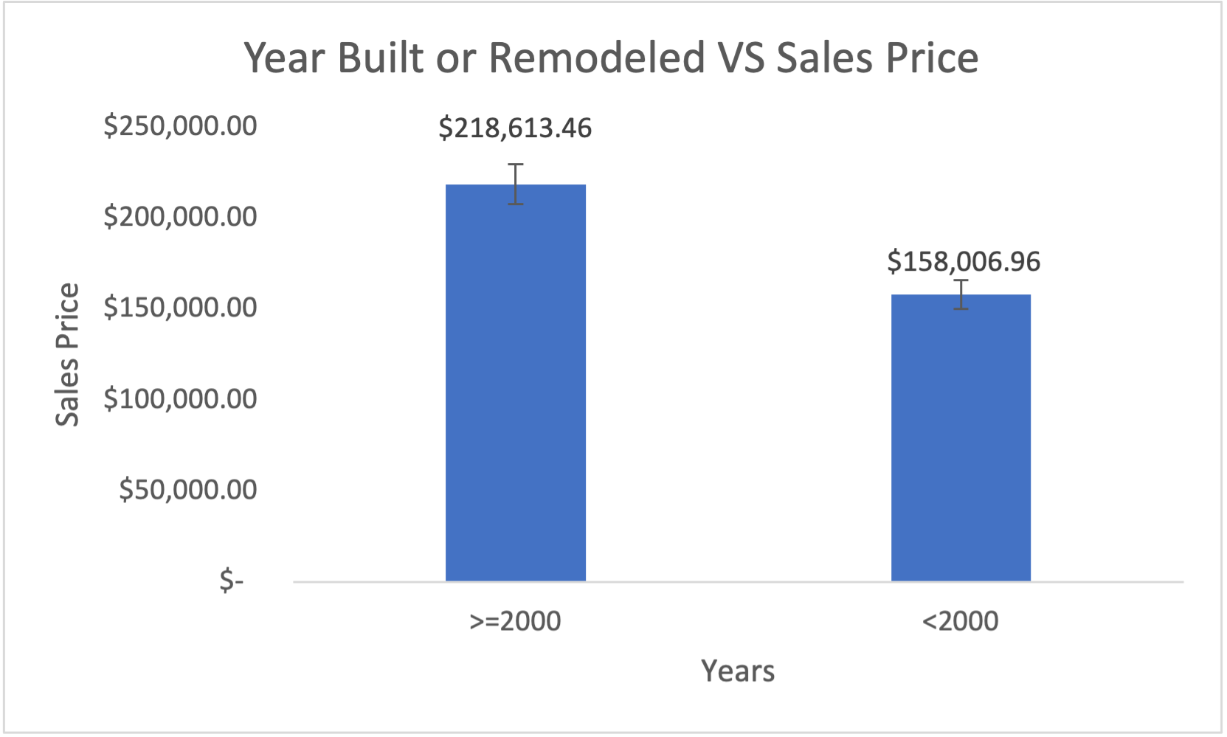
2. The effect of year built and remodeled on the selling price
T-test: Ho=no difference in mean, Ha:=difference
Year Built >=2000 vs. Year Build<2000
P<.05 at 3.6853E-42
Recommendation: The House built or remodeled in 2000 and later have a higher sales price.
Reject the null that there is no difference between the population means of number of YearsBuilt and Remodeled and and Sales Price.
This difference is significant at the <.05 level. With 95% confidence, the difference is between 52290 and 68923 means.
Notes:
Secondly, I run the test for house age. I filter the houses built in 2000 and later , and older than 2000. With 95% confidence, I can say that house built or remodeled in 2000 and later have higher sales prices.

Slide 6
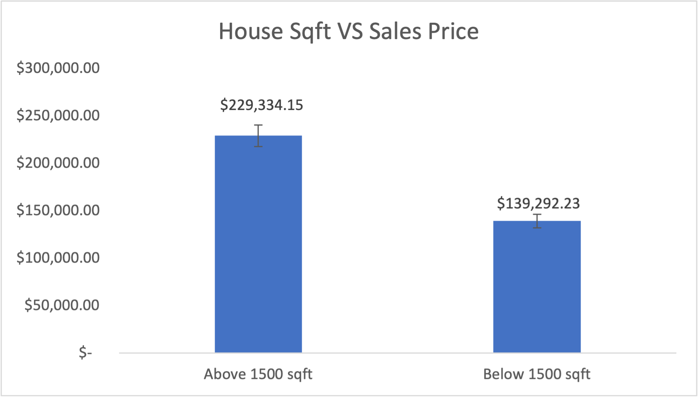
3. The effect of size of house (Sqft) on the selling price
T-test: Ho=no difference in mean, Ha:=difference
Size of house>1500 vs. Size of house=<1500
P<.05 at 1.5311E-104
Recommendation: The House has more than 1500sqft for higher sales potential.
Reject the null that there is no difference between the population means of number of House Sqft and Sales Price.
This difference is significant at the <.05 level. With 95% confidence, the difference is between 82941 and 97143 means.
Notes:
In this t-test I wanted to see is the sqft prices affecting, house prices? Average home sqft is about 1500. So, I compare houses has more than 1500 sqft and houses less than 1500sqft. The test showed us the house has more than 1500sqft way higher sales potential.

Slide 7
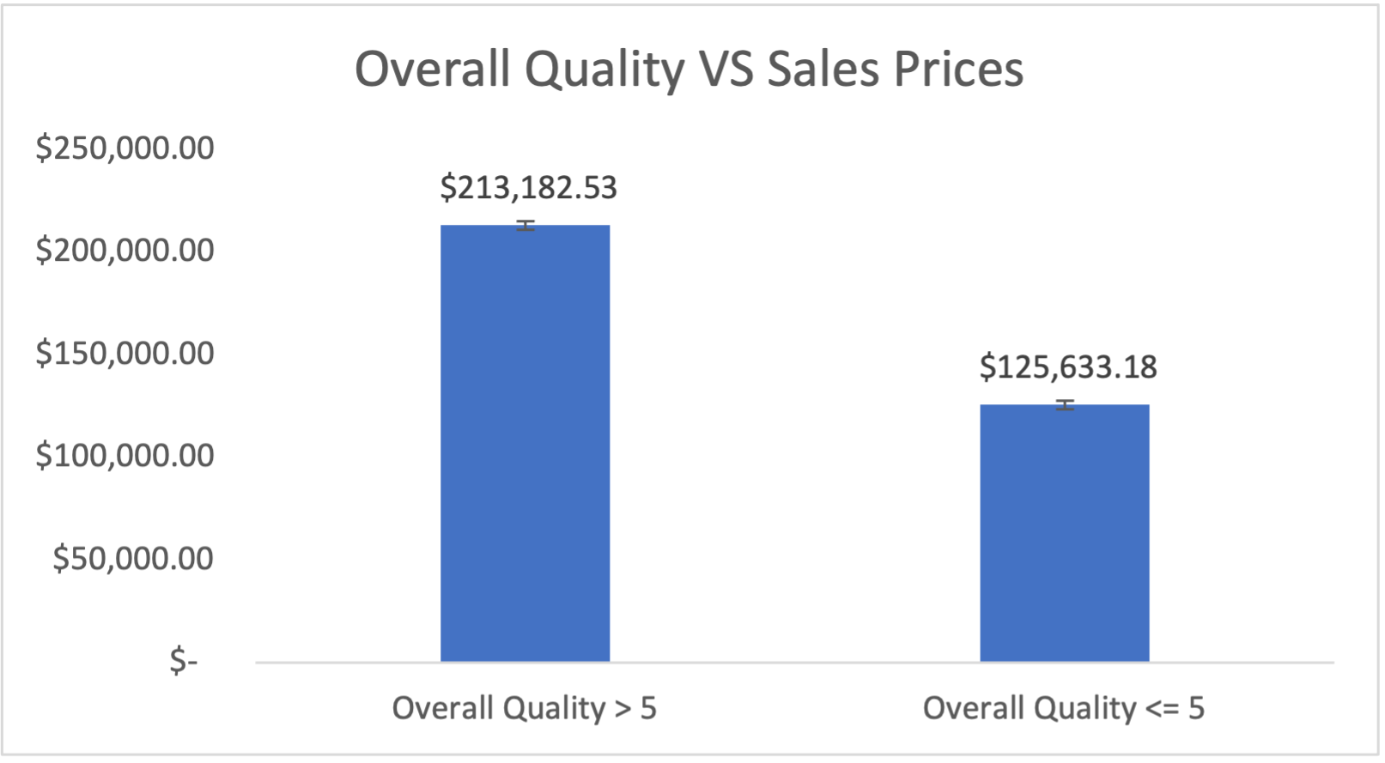
4. The effect of overall quality on the selling price
T-test: Ho=no difference in mean, Ha:=difference
Overall Quality <= 5 vs. Overall Quality >5
P<.05 at 5.9183E-145
Recommendation: Houses with overall quality higher than 5 are sold in higher price.
Reject the null that there is no difference between the population means of overall quality and and Sales Price.
This difference is significant at the <.05 level. With 95% confidence, the difference is between 81679 and 93420 means.
Notes:
Yes.! Overal Quailty vs sales prices.. Data rating the overall quality from I to 10. To be fair I compare houses has overall quality more than 5 and less than 5 rating. This test showed us p value is less than 0.05 so, I can say with 95 % confidence level, the difference is between 81 679 and 93 420.

Slide 8
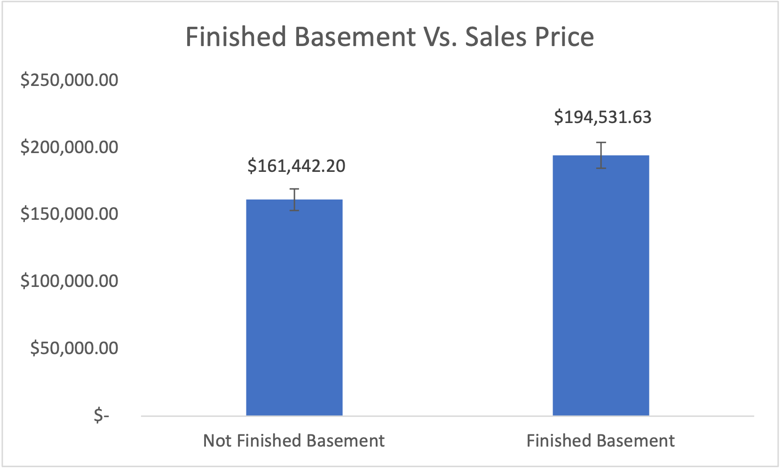
5. The effect of finished basement on the selling price
T-test: Ho=no difference in mean, Ha:=difference
Unfinished basement vs. Finished basement
P<.05 at 2.39189E-16
Recommendation: Houses with finished basement are sold at higher prices than houses with unfinished and are in greater demand.
Reject the null that there is no difference between the population means of finished basement and Sales Price.
This difference is significant at the <.05 level. With 95% confidence, the difference is between -40910 and -25269 means.
Notes:
Lastly, I wanted to compare finished basement and unfinished basement. When I complete my test with %95 confidence level , I can say that houses with finished basement are sold little bit higher than houses with unfinished basement.

Slide 9
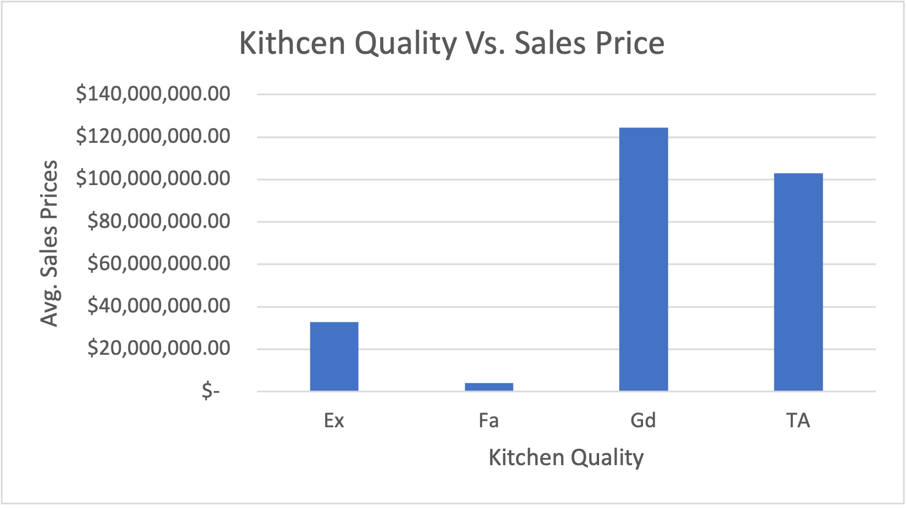
1.Future considerations: Kitchen Quality
Kitchen Quality | Sum of SalePrice
Ex | $ 32,855,467.00 | Excellent
Fa | $ 4,117,043.00 | Good
Gd | $ 124,299,990.00 | Typical/Average
TA | $ 102,872,446.00 | Fair
Grand Total | $ 264,144,946.00 | Poor
Notes:
In addition to these, I made a quick analysis of other variables. I did not apply t-test for all of them one by one, but I want to talk about them quickly as future consideration.
the first of these is kitchen quality
We see that the houses in average and fair condition have more sales, this may be due to the fact that the houses are more accessible in this range, or maybe the prices are low, but there are too many sales that’s why the total sales price is high.

Slide 10
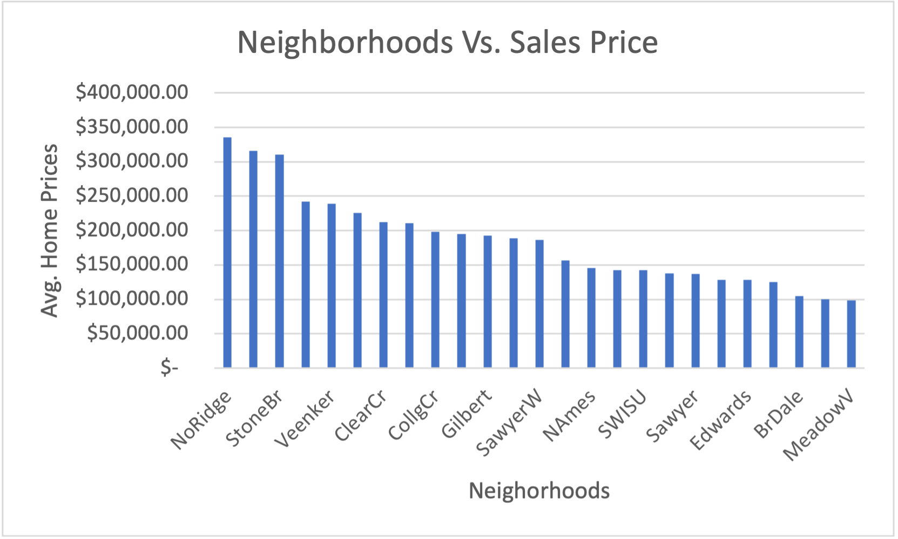
2. Future considerations: Neighborhoods
Notes:
Another topic is neighborhoods. As we all know, some neighborhoods may be more expensive than other neighborhoods due to reasons such as crime rate, income level, social facilities and school rankings etc. With the data I have, I prepared this chart. It is listing the neighborhoods from the most expensive to the cheapest. this can be the subject of further research.

Slide 11
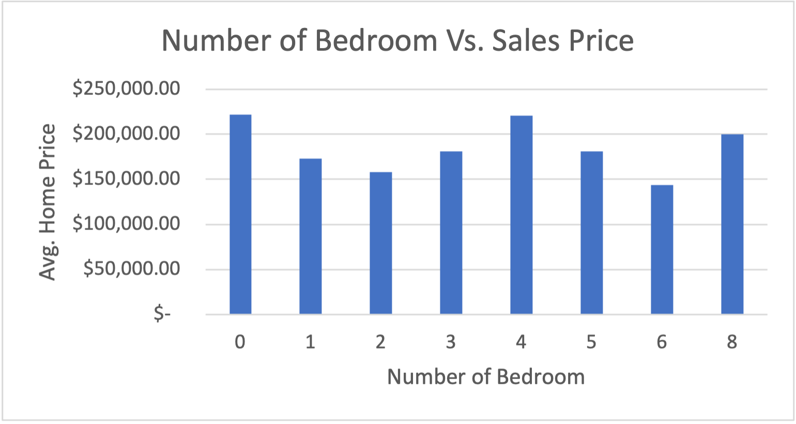
3. Future considerations: Number of Bedroom
Notes:
It is one of the most popular topics when buying a house.
How many rooms would you like to buy a house with?
Before I started doing analysis, I thought this would be a very important parameter. But when I looked at this histogram, where the number of rooms and the price ratio, I actually thought that it was not a very important parameter. I haven't done a t-test about it, but it also could be the subject of future analysis.

Slide 12
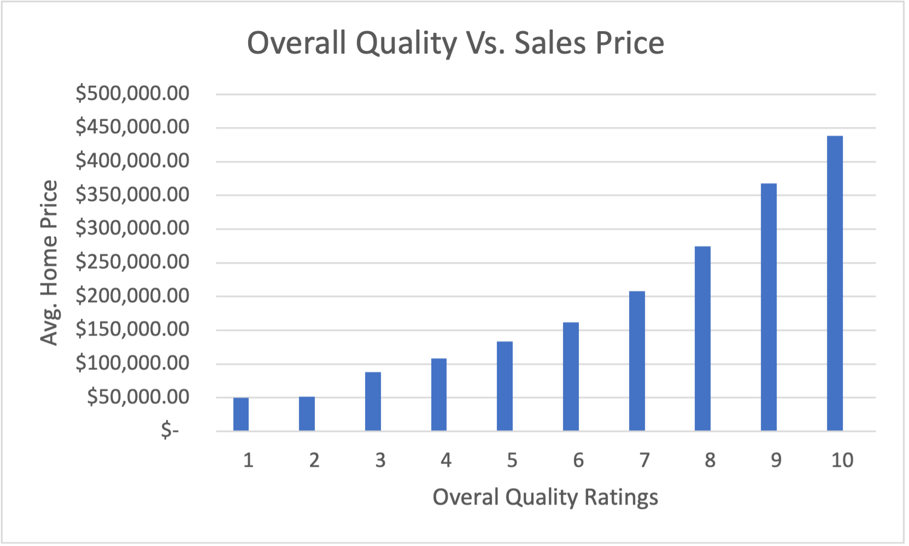
Largest Factor-1
In the analysis, I realized that overall quality is one of the most influential factors on house prices. When we compare the overall quality as less than 5 and more than 5, we see that there is an almost double of difference.
In addition, in the second histogram, it is shown that the increase in quality and the sales price are directly proportional.

Slide 13
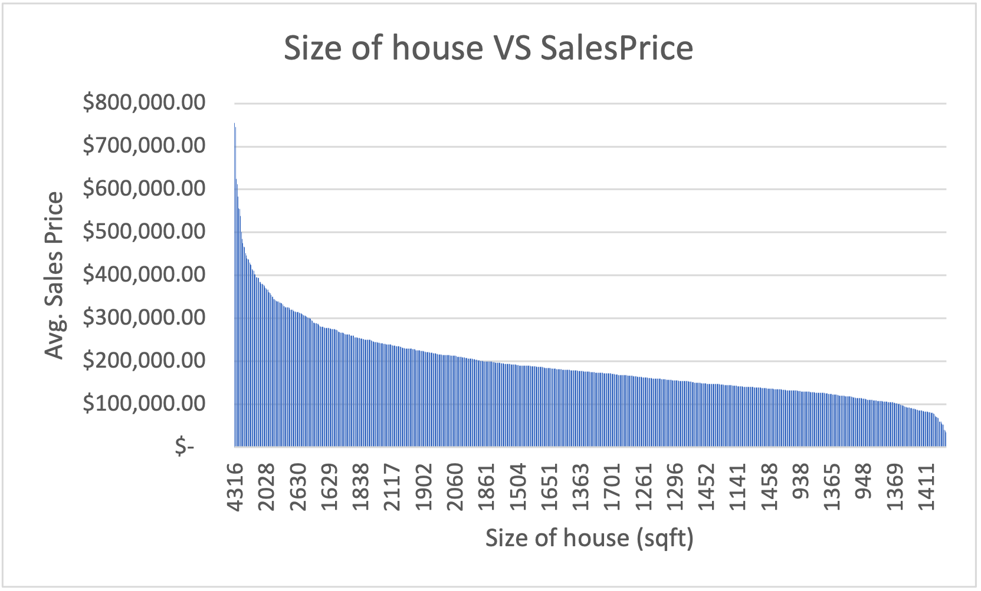
Largest Factor-2
Another important factor is of course the size of the house. We compared under and over 1500 sqft in T-test and you can see that the difference is almost double.
In addition, in the histogram on the side, it is clearly seen that the price increases as the sqft increases.

Slide 14

Conclusion
The variable that can drive home prices:
Overall quality
House size (sqft)
Garage cars
Year built and remodel added
Finished basement
Future Considerations:
Neighborhoods
Number of bedroom
Kitchen quality
Notes:
To summarize, there are many factors that affect house prices, although this varies from person to person, I can make a general conclusion in my research on 1450 houses. The factors that most affect house prices, especially house size and oval quality, are listed from top to bottom. In addition to these, Kitchen Quality, Neighborhoods and number of bedrooms can also be considered as future considerations and may be useful for future research.

Slide 15
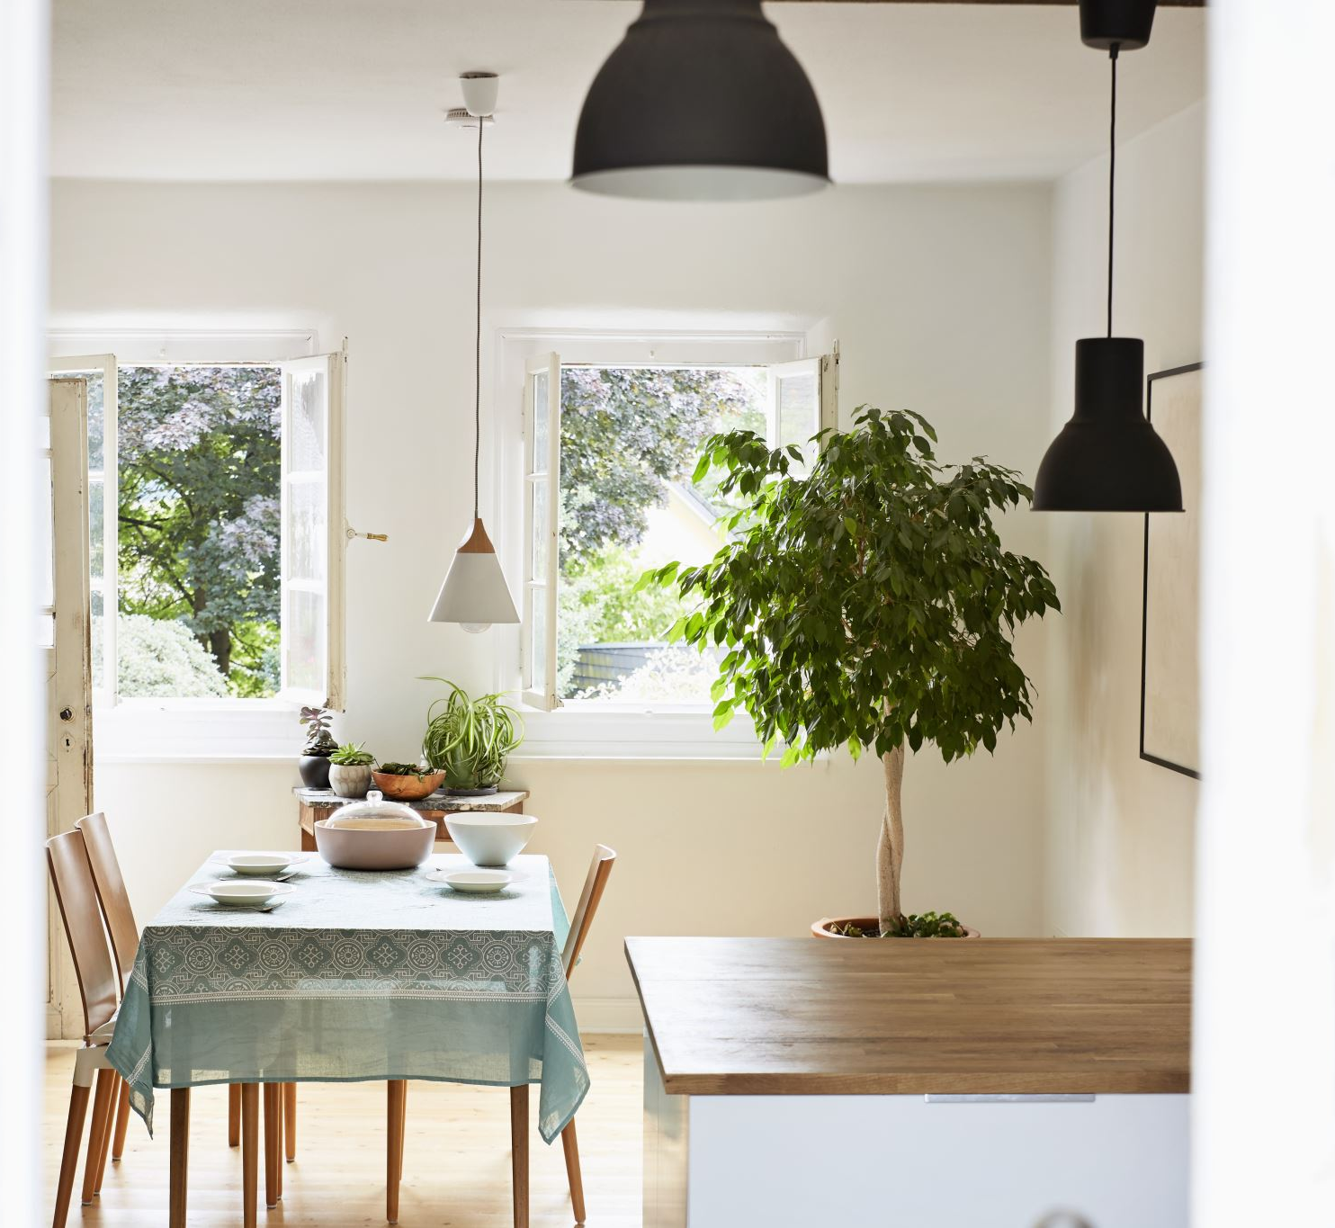
Thank you
MELIKE KARAMAN YILMAZ

